Slide 1

Purposive course redesign: promoting inclusion, engagement, mastery, and persistence
A presentation for: The Lilly Conference – Traverse City 2019
Dr. Amy Sue DeSonia, CPA; Dr. Tomeika Williams
October 18, 2019
Notes:
NOTE:
To change the image on this slide, select the picture and delete it. Then click the Pictures icon in the placeholder to insert your own image.

Slide 2
Session Goals and Objectives: Participants will be able to
Identify when course redesign is warranted
Choose an integrated course design model
Design a learning environment that promotes inclusion, engagement, mastery, and persistence by
Contextualizing a course within the curriculum
Defining measurable learning outcomes
Understanding and overcoming limitations and biases
Determining appropriate teaching strategies, learning experiences/assignments, and assessments
Notes:
In our recent experience – the format and content emphasis of the professional certification examination had changed and our annual outcomes assessment data indicated the need to align the content and sequencing to match.

Slide 3
Common reasons to engage in course re-design
Course serves as a “gateway” or foundation
Course has high enrollment, high attrition
There is a need to improve student mastery while reducing the cost of instruction
Periodic review and evaluation of student and institutional performance indicates the need
To provide a more individualized learning experience or foster an environment of inclusion and higher levels of engagement
Disruptive changes in industry or professional standards or other external factors make it necessary
Others?
Notes:
Not only did we want to align the program core with the content and format of the CPA and CMA exams – but we also wanted to ensure that the design would create an environment for inclusion and higher levels of active participation and engagement.

Slide 4
Considerations: The 6 Ps
Purpose – why are we engaging in course design? When?
Perspectives – whom are we engaging?
Philosophy – what framework should we use?
Process – how should we approach the work?
People (students and faculty) –
who takes the course? who teaches it?
what do they need to take away?
how can we draw on past learning and experiences?
why do they take the course?
when (context)? where (mode)?
are there any potential biases and barriers that need to be addressed?
Principles (of learning) – what do we know about the ways in which people learn?

Slide 5
Integrated Design Components (Fink, 2003)
Contextualization
Measurable, and attainable outcomes
Feedback and assessment procedures
Learning experiences and teaching techniques

Slide 6
Stages of Understanding by Design or UbD
(Wiggins and McTighe, 1998 and 2008)
Identify desired results (what students need to know and be able to do)
Long-term goals for transfer of learning
Knowledge and skills necessary to attaining the long-term transfer goals
Essential questions to be explored (no single right answer)
Determine assessment evidence (ways that we will know what students have learned and are able to do what is desired)
Performance tasks and products that will demonstrate the ability to make meaning and transfer learning to other situations and settings
Other evidence (i.e., traditional methods – quizzes, observation, reflective papers)
Plan the learning experiences and instruction (based on the results from Stages 1 and 2)
Resources, activities, experiences and lessons that will lead to the desired results
Sequencing and differentiation of the activities, experiences, and lessons
Instructional approach and teaching methods aligned with goals
Notes:
This is a thoughtful process that takes time. For our redesign – we established a Task Force (content experts, instructional design team, and practitioners/potential employers) and conducted held 5 8-hour-day long meetings during the Fall semester to work through the 1st 2 stages for each of the 13 courses to be addressed – after individuals had done a significant amount of research and reviewed the alignment of the existing learning outcomes for the program and each course with the outcomes specified in blueprints for each of the professional exams. The design (Phase 3) was spread across the Spring semester (8 courses) and Summer intercession (5 courses). It was undertaken as a collaboration between the instructional design team and content experts who had taught the courses online and face-to-face (traditional mode).

Slide 7
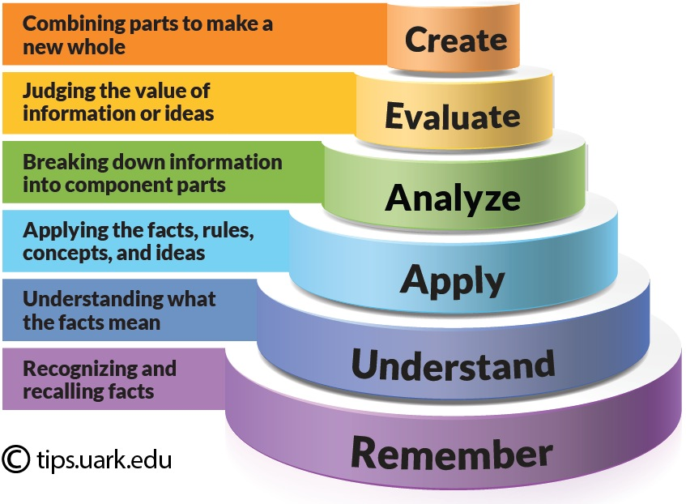
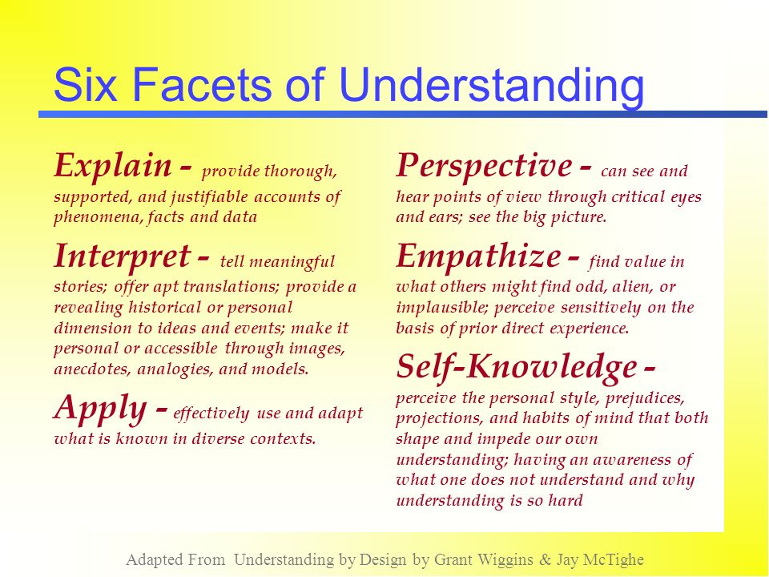
Bloom’s Taxonomy vs. Wiggins/McTighe’s 6 Facets of Understanding
Bloom’s Taxonomy
Wiggins and McTighe

Slide 8
The 7 Principles of Learning (Ambrose, Bridges, et al, 2010)
A student’s prior knowledge can either help or hinder learning
How a student organizes knowledge influences how s/he learns and applies what s/he knows
A student’s motivation determines, directs, and sustains what s/he does to learn
To develop mastery, a student must acquire component skills, practice integrating them, and know when to apply what they have learned
Goal-directed practice coupled with targeted feedback enhances the quality of a student’s learning
A students’ current level of development interacts with the social, emotional, and intellectual climate of the course to impact learning.
To become a self-directed learner, a student must learn to monitor and adjust his/her approaches to learning.
Notes:
Critical consideration was given to the facets of understanding and principles of learning throughout the process – but was a particular focus in Phase 3.

Slide 9
Designing a Learning Environment that Incorporates the 7 Principles of Learning
The learning environment should:
  Value and engage what each student brings to the table
  Actively confront and challenge misconceptions
  Emphasize both individual skills and their integration
  Explicitly teach for transfer •
  Provide multiple opportunities for authentic practice that is:
    Oriented toward clear goals •
    Coupled with targeted feedback
Notes:
For our project – we integrated adaptive learning platforms that allow students to review, learn, and practice applying key concepts and principles through a variety of means and aligned the major assessments directly to the desired learning outcomes. We carefully planned what should happen in face-to-face sessions as well as how students taking the course online would explore the essential questions through discussion – thinking about how instructors could adapt delivery based on their observations about performance. (i.e., clarifying common misunderstandings or misapplication of principles and professional standards).

Slide 10
Six major models for Course Redesign (National Center for Academic Transformation)
Supplemental - retains the basic structure of the traditional course and a) supplements lectures and textbooks with technology-based, out-of-class activities, or b) also changes what goes on in the class by creating an active learning environment within a large lecture hall setting.
Replacement - reduces the number of in-class meetings and a) replaces some in-class time with out-of-class, online, interactive learning activities, or b) also makes significant changes in remaining in-class meetings.
Emporium - replaces lectures with a learning resource center model featuring interactive computer software and on-demand personalized assistance.
Fully online - eliminates all in-class meetings and moves all learning experiences online, using Web-based, multi-media resources, commercial software, automatically evaluated assessments with guided feedback and alternative staffing models.
Buffet - customizes the learning environment for each student based on background, learning preference, and academic/professional goals and offers students an assortment of individualized paths to reach the same learning outcomes.
Linked workshop - provides remedial/developmental instruction by linking workshops that offer students just-in-time supplemental academic support to core college-level courses.
Notes:
We used the supplemental model for the face-to-face course and the fully online model for online delivery. We would not that each course contains assessments worth 1,000 points – and there are 860 points assigned to common major assessments that are mapped directly to the desired learning outcomes for the course. Every instructor then has 140 points to design activities that require active engagement, and can be adapted to the dynamic and needs of their class.

Slide 11
Tools, Technology, and Techniques
Adaptive learning platforms
Audience response systems
Simulations
Virtual reality/AI (Artificial Intelligence)
Collaboration tools – video conferencing, Google
Service learning
Community-based or action research projects
(List is not exhaustive, new things keep emerging)

Slide 12

Redesigning VIT 1310
Form a group of 3 – 4
Review the handout with facts about the current course design and student performance.
Address the following questions:
Does the current design promote inclusion and engagement? Mastery, and persistence? Why, or why not?
Does the current design: contextualize the course in the curriculum; contain measurable learning outcomes; contain appropriate teaching strategies, learning assignments and activities, and assessments?
Is a redesign warranted for this course? Why, or why not?
Which model might you suggest be used in a redesign of the course? Why?

Slide 13
References
Ambrose, S.A., Bridges, M.W., DiPietro, M., Lovett, M.C. and Norman, M.K. (2010). How learning works: seven research-based principles for smart teaching. Wiley and Sons
Chickering, A.W. and Gamson, Z (1991). Applying the seven principles for good practice in undergraduate education. San Francisco: Jossey-Bass
Fink, L. D. (2003). Creating significant learning experiences: an integrated approach to designing college courses. San Francisco: Jossey-Bass
Tomlinson, C. and McTighe, J. (2006). Integrating differentiated instruction and understanding by design. Heatherton, Vic: Hawker Brownlow Education.
Wiggins, G. and McTighe, J. (2008). Understanding by design. Alexandria, VA: Association for Supervision and Curriculum Development.

