Slide 2
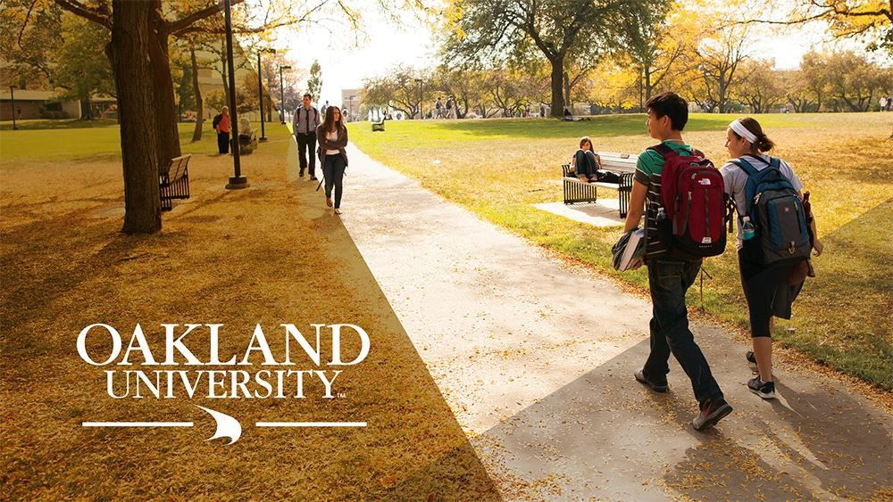
Reinvent the Textbook:
A New OER Approach to Teaching
Caterina Pieri
DMLL
College of Arts and Sciences
Fall 2019
pieri@oakland.edu

Slide 3
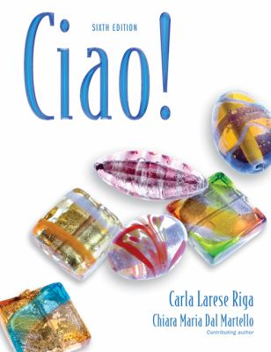
Previous Materials
$214
loose leaf
+
24 months access code

Slide 4
Previous Materials

Slide 5
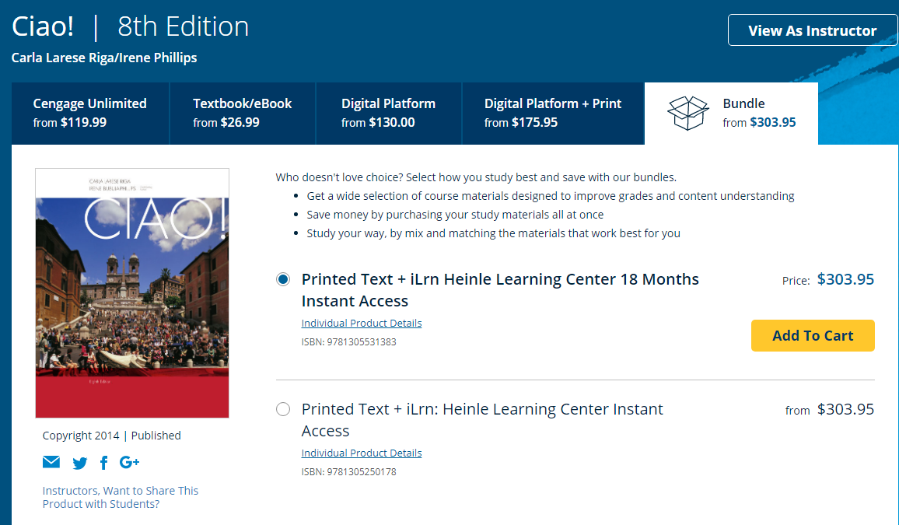
Previous Materials

Slide 6
Motivation
Program Growth
2 years → Italian Minor
Innovative Study Abroad
Online or Hybrid courses
Student Success
Day 1 access
Tailored to the course
Peace of mind

Slide 7
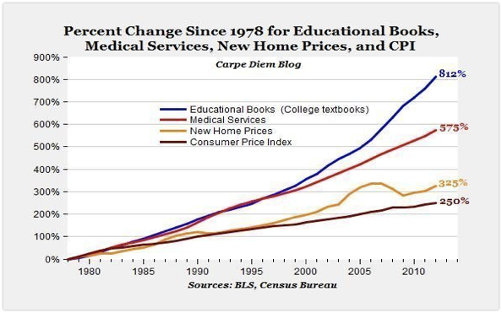
Cost of Textbooks

Slide 8
OER Definition
Open Educational Resources (OER) are teaching, learning and research materials in any medium – digital or otherwise – that reside in the public domain or have been released under an open license that permits no-cost access, use, adaptation and redistribution by others with no or limited restrictions.
-UNESCO

Slide 10
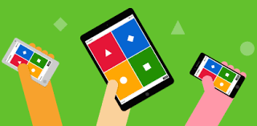
Gamification is a word

Slide 11
#TextbookBroke
The College Board advises students to budget $1,298 annually for books & materials.
However, the National Association of College Stores (NACS) says the average college student spends around $579 a year on textbooks.
How to explain the difference?
● Students don’t buy required textbooks (perhaps as many as ⅔)
● Students don’t buy the current edition
● Students take fewer courses (perhaps as many as ½ of all students)
Source: UW-Madison Pressbooks Users Group

Slide 12
OER Initiative Timeline
Summer 2017
Fall 2019
Faculty initiative
Dean’s Task Force
Senate resolution
Student Congress support
Provost endorsed ACMI
Learning Community

Slide 13
Next Step
Registrar’s course designation on Banner

Slide 14
ACMI Objectives
The Affordable Course Materials Initiative
at OU
Raises Awareness
Educates
Supports

Slide 15
The Search

Slide 16
Search Results
Fake OER (commercial, non-editable)
Obsolete
Sparse
Not for college students

Slide 17
Can I possibly be the one who creates the first true OER for Italian?

Slide 19
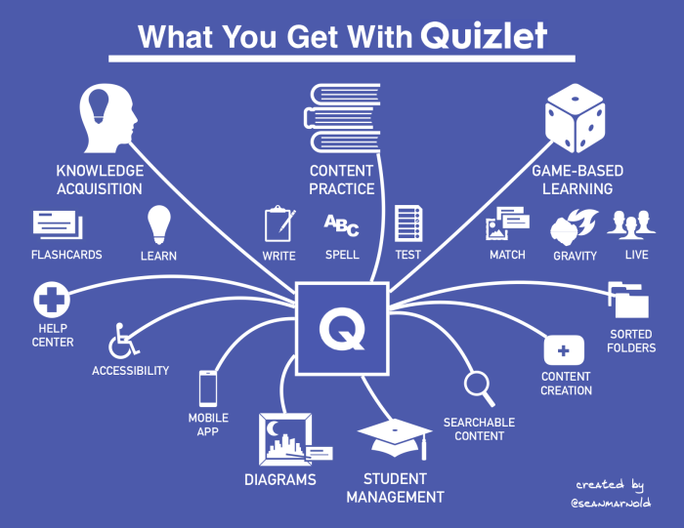

Slide 20
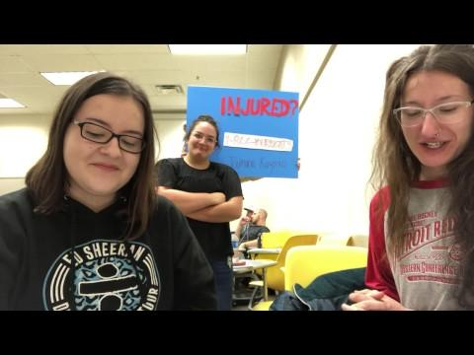
Student-made videos

Slide 21
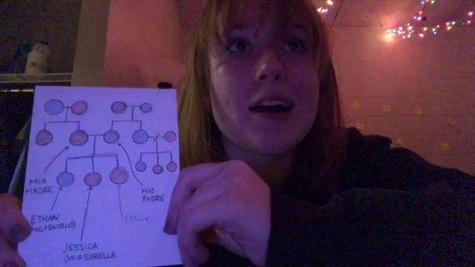
Student-made videos

Slide 22
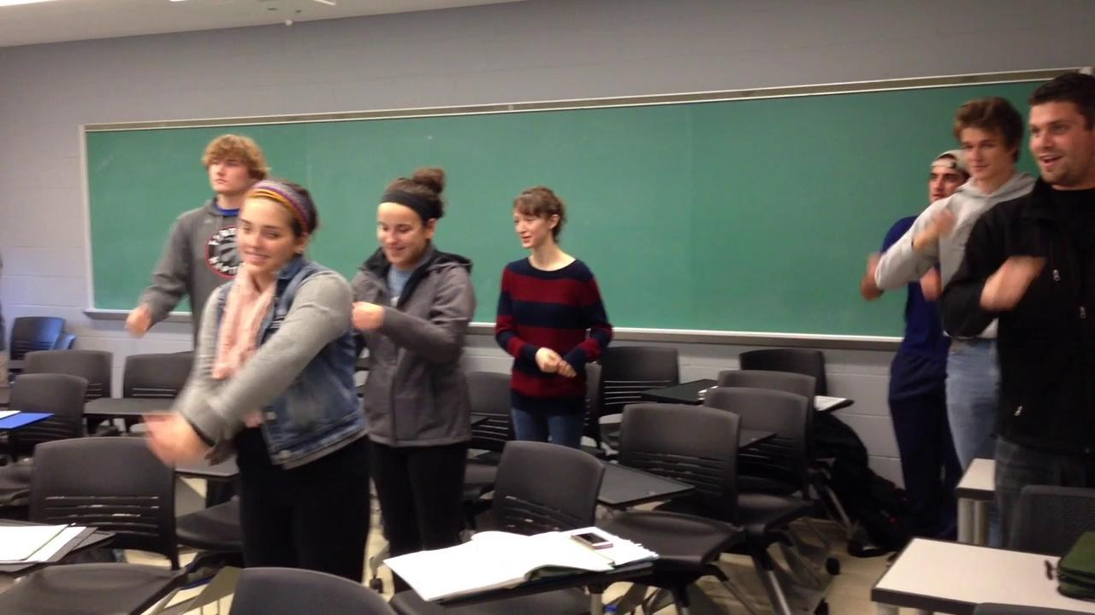
Songs

Slide 23
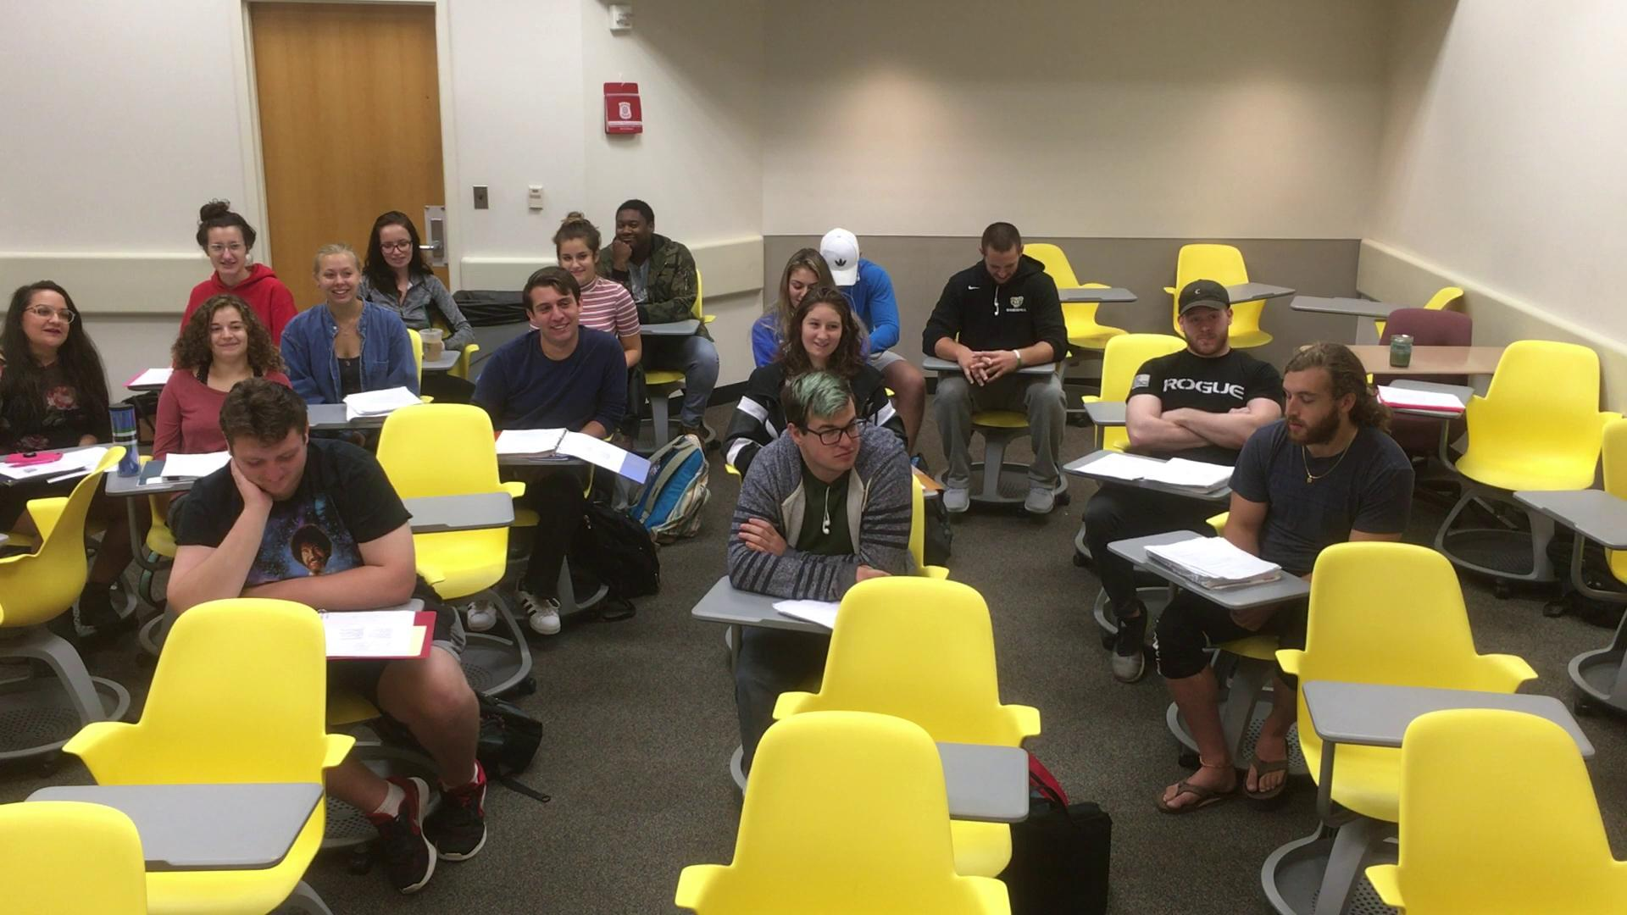
Scripted dialogues

Slide 24
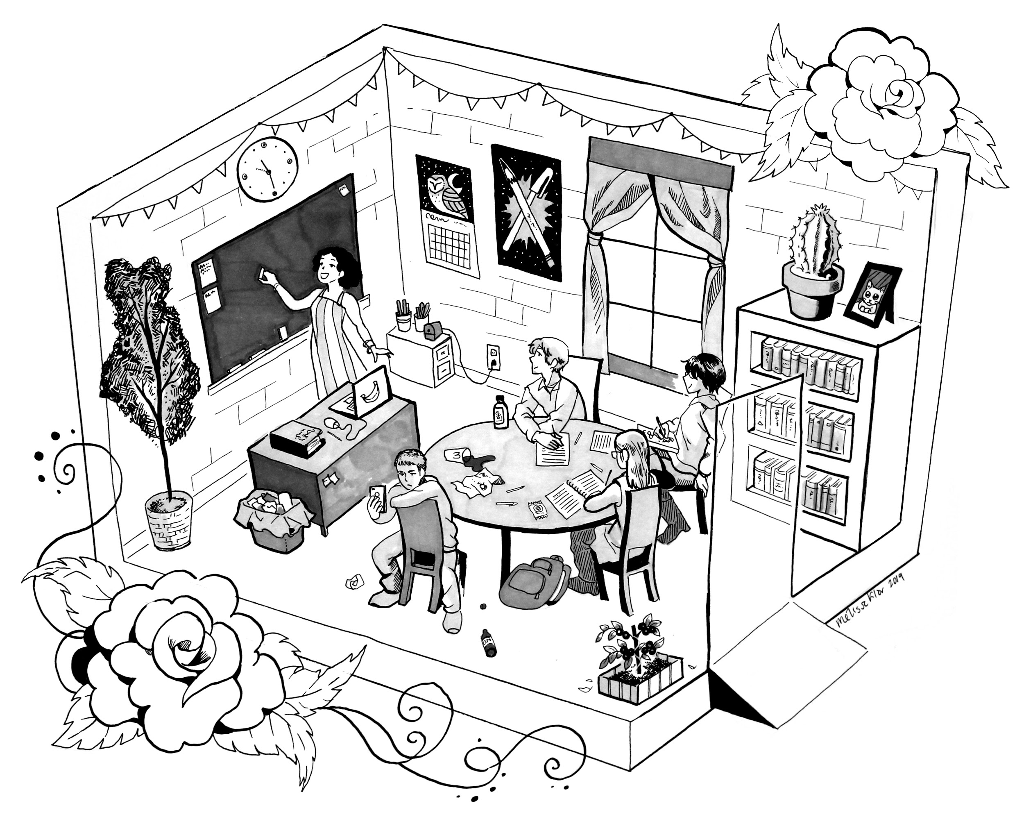
Original illustrations

Slide 25
Introduction to Italian Language and Culture I
tinyurl.com/it-intro1
Introduction to Italian Language and Culture II
tinyurl.com/it-intro2

