Slide 1
Evaluating Students’ Experiences in Traditional and Economy Active Learning Classrooms
Matt Johnson, Ph.D.
Educational Leadership
Jesse Eickholt, Ph.D.
Computer Science
Patrick Seeling, Ph.D.
Computer Science
Quentrese Hinton, M. A.
Educational Leadership

Slide 2
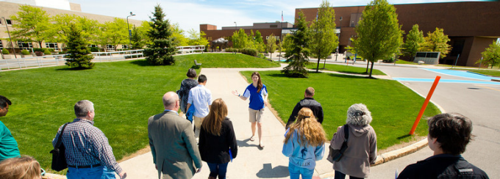
Imagination Exercise

Slide 3
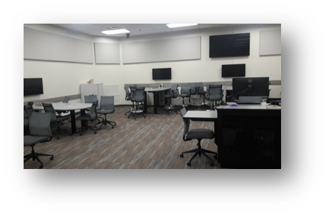
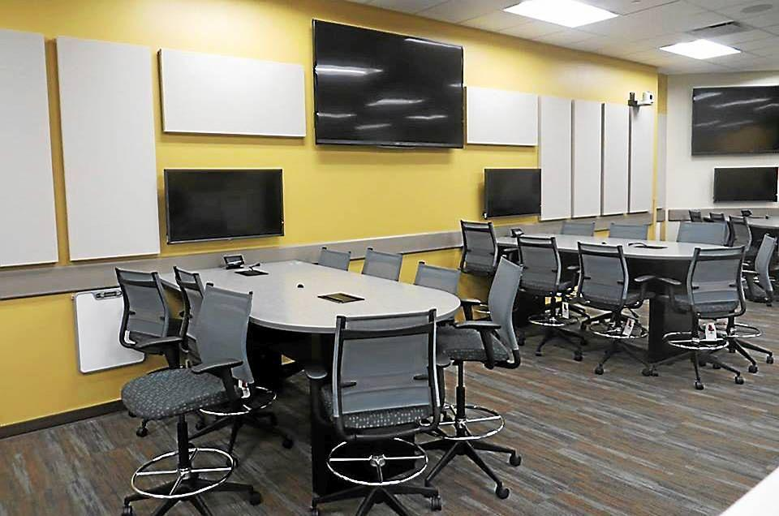
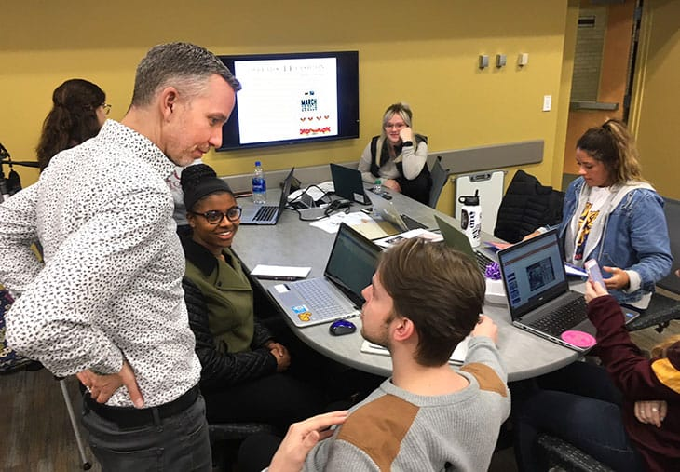
Imagination Exercise

Slide 4
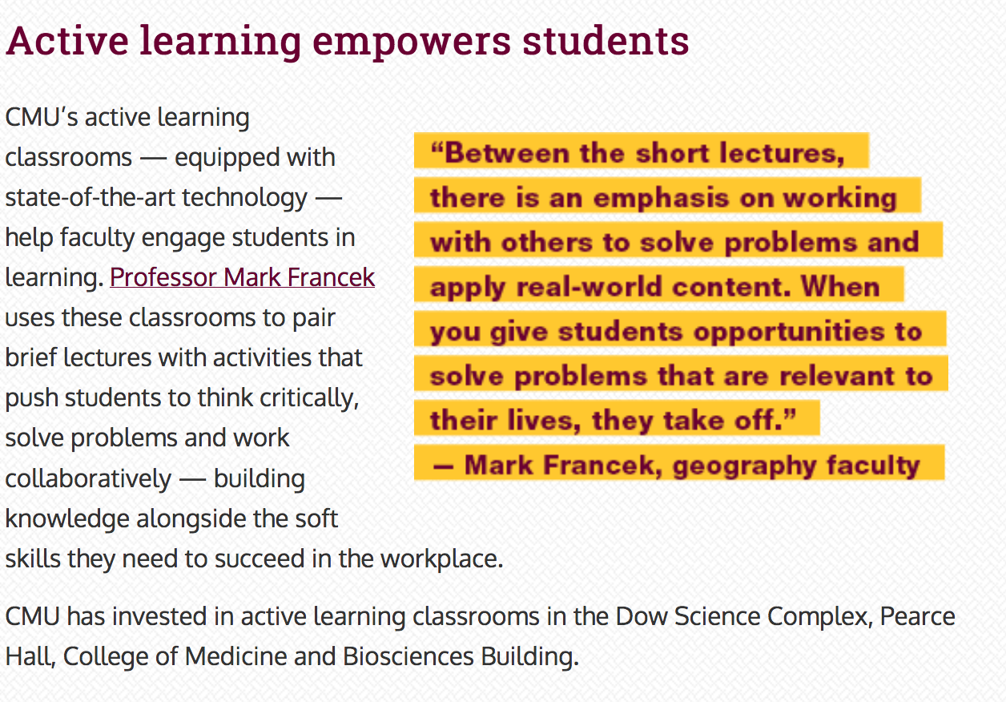

Slide 5
Active Learning: What
Active Learning is any activity that engages students in the learning process such that they take part in the construction of their knowledge and understanding as opposed to being passive recipients. Students have to think about what they are doing while learning.¹
1. Prince, M., Does Active Learning Work? A Review of the Research. Journal of Engineering Education, 93, 3:223-231, 2004.

Slide 6
Active Learning: How
AL Techniques
AL Frameworks
AL Environment & Technology
Minute Paper
Think-pair-share
Muddiest point
ARS (i.e., clicker)
Discussion
Process oriented guided inquiry learning (POGIL)
Team based learning (TBL)
Problem based learning (PBL)
Peer Instruction
Space
Layout (e.g., TEAL, SCALE-UP)
screensharing
collaboration software (e.g., Google Docs)
Instructional Strategies
Supports and Enablers
span spectrum
Baepler, P. Walker, J.D., Brooks, D.C., Saichaie, K. and Petersen, C.I. A guide to teaching in the active learning classroom, Sterling: Stylus, 2016.

Slide 7
Active Learning Classrooms
Existing Designs and Work
There are a number of existing ALCs designs that have been developed and studied (e.g., SCALE-UP, TEAL, CoWs, etc.).
Baepler, P. Walker, J.D., Brooks, D.C., Saichaie, K. and Petersen, C.I. A guide to teaching in the active learning classroom, Sterling: Stylus, 2016.
Park, E.L and Choi, B.K., Transformation of classroom spaces: traditional versus active learning classroom in colleges, Higher Education, 68, 5:749-771, 2014.
Evans, R. and Cook, R. In the right space: exploring the dynamics between design, environment and pedagogy. In proceedings of 31st ascilite conference.

Slide 8
Active Learning Classrooms
Costly ($250,000 average cost)
Space limitations
Hanging monitors
HVAC
Electrical restrictions
Lack of ability to transform to different classroom setups

Slide 9
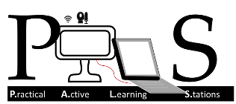
Motivation for PALS
Question
Implementation Checklist
Can we create an economical platform to support active learning? How will it compare to existing models terms of student perception and performance?
Our answer is PALS (i.e., Practical Active Learning Stations).
Leverage existing infrastructure as much as possible.
Utilize commodity software and hardware instead of ‘turn-key’ solutions.

Slide 10
PALS Implementation: Classroom
Before …

Slide 11
PALS Implementation: Classroom
… After

Slide 12
PALS Student Station
Specs
Mini-ITX board
23’’ LCD display
HDMI-to-USB dongle
Celeron 2 core 2GHz
Software
CentOS7 w/ X windows/MATE
ffMPEG to display local content and share with ffServer
V4L2

Slide 13
PALS Instructor Station
Specs
Raspberry Pi 3
Display mirrored locally and thru classroom A/V system
Software
Raspbian OS
Custom WebUI using node.js

Slide 14
Practical Active Learning Stations (PALS) - COSTS
Total Cost: $10,000 (1/25th the cost of traditional ALCs)
Each PALS unit was constructed from new components for ~$700 each.
Large, commodity LCDs on carts.

Slide 15
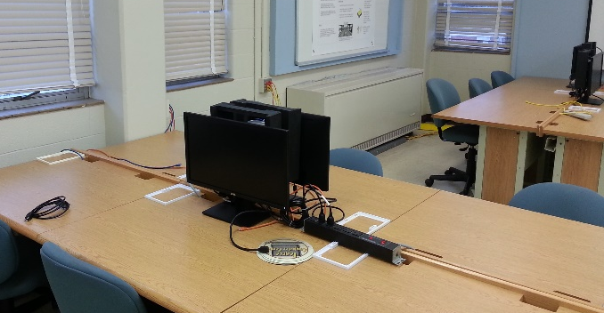
Comparing PALS to Existing ALC Technology
Almost exactly the same in terms of functionality (e.g., screenshare, projecting, plug in own device, broadcasting)
Fewer “bells and whistles” than traditional ALC (i.e., no pager, microphones, cameras)

Slide 16
The Ultimate Question
Do students learn and perceive the economy-based PALS technology in the same ways they do in the traditional active learning classroom?
VS
Value of the technology?
Are economical options effective?

Slide 17
Research Design
We compared PALS vs. Traditional Active Learning Classrooms (five semesters, class sizes around 30, two different computer science courses, 305 students total)
Setting
Measurements
Three semesters: Introductory computer science course
Two semesters: Advanced computer science course
Same instructor for each course, content, time of day, length, pedagogy, tests, grading system.
Only difference was the technology (PALS vs. AL)
Performance and Perceptions
Pre-/post-test
Pre-/post-survey
3 programming assignments
Final exam
Focus groups

Slide 18
Results
Performance – what do you think we found?
Tests
Final exam
Final grade
Self-assessments of their learning
Perceptions – what do you think we found?
Focus groups (perceived value of technology, likeability)
Surveys (perceived value of technology, likeability)

Slide 19
Results
Performance – what do you think we found?
Tests – no differences
Final exam – no differences
Final grade – no differences
Self-assessments of their learning – very minimal differences (slightly higher for PALS in some cases)
Perceptions – what do you think we found?
Students generally liked the PALS system better
We found no evidence that students preferred the traditional active learning classroom

Slide 20
Discussion
Why do you think students performed no better in the $250,000 Active Learning classroom than the $10,000 PALS classroom?
Why do you think students preferred the PALS classroom?

Slide 21
References
Baepler, P. Walker, J.D., Brooks, D.C., Saichaie, K. and Petersen, C.I. A guide to teaching in the active learning classroom, Sterling: Stylus, 2016.
Cole, Q., Johnson, M. and Eickholt, J. Creating Economy Active Learning Classrooms for IT Students. In Proceedings of the 18th Annual Conference on Information Technology Education (SIGITE '17). ACM, New York, NY, USA, 77-82, 2017.
Evans, R. and Cook, R. In the right space: exploring the dynamics between design, environment and pedagogy. In proceedings of 31st ascilite conference.
Park, E.L and Choi, B.K., Transformation of classroom spaces: traditional versus active learning classroom in colleges, Higher Education, 68, 5:749-771, 2014.
Porter, L., Bouvier, D., Cutts, Q., Grissom, S., Lee, C., McCartney, R., Zingaro, D. and Simon, B, A multi-institutional Study of Peer Instruction in Introductory Computing. The Special Interest Group on Computer Science Education Technical Symposium. Memphis, TN
Prince, M., Does Active Learning Work? A Review of the Research. Journal of Engineering Education, 93, 3:223-231, 2004.

Slide 22
Acknowledgements
This material is based upon work supported by the National Science Foundation under Grant No. IUSE 1608043.
PALS Team
Jesse Eickholt Matt Johnson Patrick Seeling Quentrese Hinton

Slide 23
Questions
For more information about PALS, you can use pals.cps.cmich.edu
Feel free to email us or drop off a card if you want to kept up to date on PALS.
Matt Johnson – johns9m@cmich.edu

