Slide 1
Assessing Students’ Critical Thinking about Digital Information via Statistical Analysis
Notes:
“Advancing Teaching and Learning” Lilly Conference – Traverse City, MI – October 18, 2019

Slide 2
Welcome!
Kim L. Ranger
Faculty Librarian, GVSU
rangerk@gvsu.edu
Notes:
Assessing students’ critical thinking about digital information via statistical analysis can be very organic and sustainable. I use blue framing for teaching theory, green to highlight statistical analysis, yellow for teaching interventions.

Slide 3
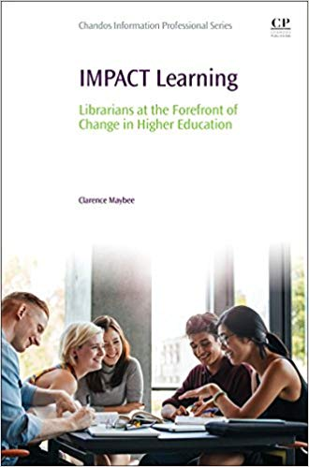
Maybee:
informed learning design
informed learning outcomes
Notes:
I used Maybee’s “Informed learning design,” explained in his 2018 book IMPACT Learning, to design the activities and to create “informed learning outcomes.”
1. Students will list criteria for a “good” website (what draws people in and keeps them there). Plenary discussion; criteria entered in the library guide.
Students will evaluate a specific website without a real product, also known as fake information (e.g., SolarBotanic) according to the criteria they chose; plenary discussion afterward.
Rough analysis showed me that a majority, (61%), of students mistakenly valued good design over the integrity of information provided in a website by failing to note that there was no real product in the website. Even when students valued credibility or facts, they were not likely to look outside the website to verify the information. However, when students chose the integrity of information over design, they noted that there was no real product or that the company didn’t really exist outside of the website. The students’ answers did not address information use or my intentions for their learning.
Maybee, C. (2018). IMPACT learning: Librarians at the forefront of change in Higher Education. Cambridge: Chandos Publishing.

Slide 4
Statistical analysis 1
Notes:
On December 3, 2018, I took the student responses for my activity to the GVSU Statistical Consulting Center as a 1st step toward assessment. Director Sango Otieno and his student collaborators used SAS to analyze the data in several ways.
(Statistics Majors/Graduate Students in Biostatics/Data Science Aubree Batchelor, Forrest Chase, and Abigail Zysk)

Slide 5
Odds Ratio and Relative Risks
Statistic | Value | 95% Confidence Limits (range)
Odds Ratio (likeliness) Website fit criteria: company & product reliable | 6 | 3 | 14
Relative Risk (probability) incorrect answer: incorrect answer | 3 | 2 | 4
Notes:
Their analysis found an “odds ratio” that students who judged that the website fit their criteria (an incorrect answer) were also about 6 times more likely to judge company and product reliability incorrectly. The consultants were 95% confident the true odds were between 3 and 14 times greater for people who answered “fit criteria” incorrectly compared to those who answered correctly.
The “relative risk” or probability of answering “reliability” incorrectly was about 3 times greater for people who answered “fit criteria” incorrectly. They were also 95% confident the true probability of answering “reliability” incorrectly was between 2 and 4 times greater for people who answered “fit criteria” incorrectly compared to those who answered correctly.
That is, students were more likely to get it wrong twice if they started out by accepting the website’s information at face value.
Revised activity!

Slide 6
Statistical analysis 2
Notes:
As a 2nd step, I worked with 2 senior statistics majors, Kourtney Dobbin & Mitch Hoezee, during the winter 2019 semester. As they analyzed the data, we discussed changes to improve the activities. Students answer the questions individually now as a “pre-test,” and I added a “post-test” with a new information source to be administered later in the semester. We edited the questions to eliminate students’ confusion and so that I would have credible results. Kourtney & Mitch found that “scaffolded” activities did not build on each other, i.e., they were statistically independent.
Dobbin, Kourtney J. & Mitch A. Hoezee. (2019). Journal/Article Credibility Analysis for: Kim Ranger [Faculty Librarian at Grand Valley State University]. Analysis done for STA 419: Professor Gabrosek.

Slide 7
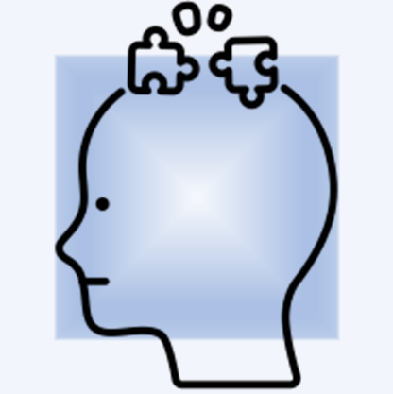
Students do better critical thinking when fact checking.
Notes:
Then I read the 2018 Phi Delta Kappan article on teaching digital literacy, which stated that checklists do not help students evaluate resources, as they keep the students focused on the material itself. I had found that even student-created or student-chosen criteria did not foster critical thinking. However, when students fact check, they are thinking critically.
Breakstone, Joel, Sarah McGrew, Mark Smith, Teresa Ortega, and Sam Wineburg. (2018). Why we need a new approach to teaching digital literacy. Phi Delta Kappan, 99(6), 27.

Slide 8
Improve your course activities: Teach
students to fact
check.
Notes:
Students don’t know intuitively how to or even to fact check. I needed better exercises in order to teach this overtly. Before plunging in to a close reading within a site in a discipline with which the students are inexperienced, Wineburg and McGrew (2017) recommend that they should “make a plan for moving forward” such as looking for independent information about the creator/s, funding, opinions or viewpoints, and statements.
I modified the informed learning objective to, “Students will find outside evidence that a website and its product or service is/is not reputable or authoritative) and did further assessment. I added objectives:
Students will find additional information about the company and product, and use that information to judge the reliability of the company and product.
Students will find evidence that a specific journal article about the company’s product is or is not reputable (citation supplied).
Wineburg, Sam, and Sarah McGrew. (2017). Lateral Reading: Reading Less and Learning More When Evaluating Digital Information. Stanford History Education Group Working Paper No. 2017-A1. http://dx.doi.org/10.2139/ssrn.3048994

Slide 9
Fact check means verify externally—
Plan
Search in tabs
Skim
Double-check
Notes:
Wineburg and McGrew found that professional fact checkers spend about “half a minute” (p. 15) on a site before they open new tabs with a right click to investigate assertions, authors, and other information. However, professional fact checkers spend about “2 minutes, 8 seconds” (p.31) to identify and verify funding for a site. The key is to spend more time double-checking the external facts rather than looking through the original site. The process includes:
Prior to lateral reading, choose types of information to research, fact check, or evaluate: (sample list below)
a. assertions made
b. authors
c. funding
d. opinions/viewpoints
e. other information
“Lateral reading” = use right-click to open new tabs in order to investigate via searching
Practice “click restraint” by spending time to skim the results after you search; read bits and pieces before choosing to click any link
“Verification” = double-checking

Slide 10
WHO WHAT HOW WHY GET IN TOUCH BLOG
THE NATURAL SHAPE OF ENERGY
Saving the world with the Energy Tree, a natural-looking, energy generator that looks like a real tree.
Notes:
Solar Botanic’s website emphasizes a sustainable, green energy technology. It’s ideal for my purposes of disrupting advertising and public relations students’ acceptance of good design as an indicator of trustworthy information.

Slide 11
Snopes, Politifact, FactCheck
Think of yourself as a professional fact checker from the [X] field/discipline.
Before exploring an information source when you're inexperienced in that discipline, make a plan.
Notes:
I explain the process for fact checking as if the students were professionals working for an organization like Snopes, Politifact, or FactCheck. Planning is key, especially when one is outside one’s area of expertise.

Slide 12
Fact check means verify externally—
What to fact check?
Open tabs for searching
Skim before clicking
Double check
Notes:
Advertising professionals often have to promote items that they’re not familiar with, and I explain the process of verifying outside of the information resource itself:
Based on the discipline of the information resource, plan what types of information would you research, fact check, or evaluate?
Use right-click to open new tabs in order to investigate: lateral reading and searching
Practice “click restraint” by spending time to skim the results after you search; read bits and pieces before choosing to click any link
Verify and double-check!

Slide 13
60 seconds
Notes:
I direct students to look through the SolarBotanic website for 60 seconds. After a minute, I ask them to begin lateral fact-checking, skimming before clicking, and answering the questions posted online.

Slide 14
libguides.gvsu.edu/cap115/eval
Truthworthy?
Reliable?
Reputable?
Yes
No
Notes:
The activity is on my library subject guide at libguides.gvsu.edu/cap115/eval. The question form asks students to answer the following questions and to explain their thinking:
1. Based on your findings, do you think the company is trustworthy? [dropdown: Yes (or) No]
2. Justify your choice: describe how the company is or is not trustworthy: [paragraph box]
3. Based on your findings, do you think the product is reliable? [Yes (or) No]
4. Justify your choice: describe how the product is or is not reliable: [paragraph box]
Do more research to find external, independent evidence that the [provided] journal article is reputable or not reputable: [Yes (or) No]
Justify your choice: describe how the article is or is not reputable: [paragraph box]

Slide 15
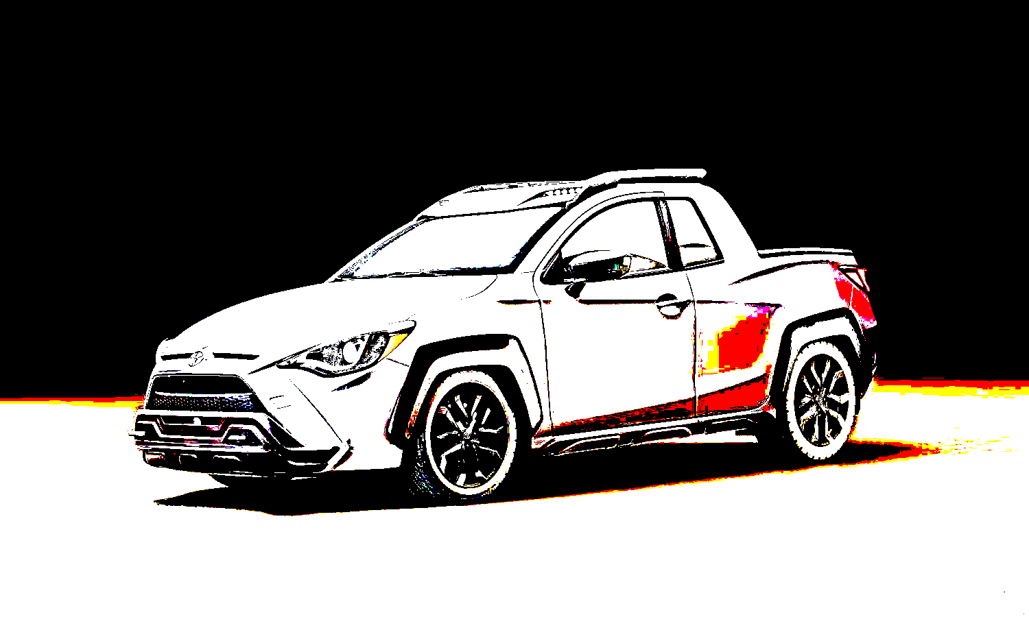
libguides.gvsu.edu/cap115/post-activity
Truthworthy?
Reliable?
Reputable?
Yes
No
Notes:
Later in the semester, students evaluate a new example, an April Fool’s press release from Toyota. This serves to assess deep thinking (long-term understanding and extrapolation skills). This also serves as a post-test, giving us quantitative comparison data. The exercise is also on the subject page at libguides.gvsu.edu/cap115/post-activity. The questions direct students to:
1. Spend 60 seconds looking at the Toyota Yaris Adventure press release, then describe the purpose (what is it trying to do for the audience?):
2. Do research about the new vehicle. Skim the results and read bits and pieces before clicking links. Make notes if you'd like to:
3. Based on your findings, do you think the Toyota company is trustworthy? [dropdown: Yes (or) No]
4. Based on your findings, do you think the Yaris Adventure is reliable? [Yes (or) No]
5. Is the press release reputable or not? [Reputable (or) Not reputable]

Slide 16
Statistical analysis 3
62% correctly answered last question in post-test
McNemar’s test for agreement
Exact Pr >= S | 0.0018
Students treated 2nd & 3rd questions as dependent (scaffolded)
Monte Carlo Estimate for the Exact Test
Pr <= P | 0.0034
Notes:
My intention was to use scaffolding to build students’ skills of evaluating information by having dependent, that is, related questions. The 2nd statistical analysis showed me that the students treated the original questions as independent and did not extrapolate from the first to later questions. By revising the activity and collecting more data, the 3rd analysis indicates that students are able to apply critical thinking more readily as they progress through the exercise, and extrapolate by applying that judgment to a new example on the post-test, as evidenced by 62% answering the last question of the post-test correctly, with the p-value of .0018. Also, the p-value of .0034 indicates a dependent relationship between the 2nd and 3rd questions – so perhaps the scaffolding is better designed. This is based on a small sample size, so I’ll continue to collect data.
This type of activity is easily modified/adapted for various types of resource evaluation across disciplines.
University instructors, including librarians, should think of statistical analysis as a way to examine student learning and improve teaching activities. This may be done within a single course if the analysis is conducted over multiple sections and/or semesters.

Slide 17
“Source criticism:
start somewhere....”
Notes:
In 2017, Johannessen wrote that, “Source criticism is connected to knowledge and practice in a field, which can only truly be achieved through experience. However, students need to start somewhere to gain this experience” (p. 92) and “source criticism is also important even before one starts the actual searching process. Choice of search terms affects the search result and consequently what sources one is left with to evaluate” (p. 94).
Johannessen, H. (2017). “Teaching source criticism to students in Higher Education: A practical approach.” In Siri Ingvaldsen & Dianne Oberg (Eds.), Media and information literacy in Higher Education: Educating the educators (89-105). Cambridge: Chandos Publishing.

Slide 18
Adapt for your discipline: Think/pair/share
Plan, search in lateral tabs
Skim: practice click restraint
Double check (verify)
Notes:
My backstory and examples of a well-designed website without a real product and a fake press release, are for advertising and public relations students examining digital objects. How can you modify this for students in your classes or field? Choose one course for this activity, think about it, share with a neighbor, and consider sharing to the whole group, remembering the 3 elements of lateral searching, skimming before clicking, and verifying.
(Give time, call back to whole, ask for examples)

Slide 19
To evaluate is to question!
 | Lateral tabs | Click Restraint | Double check
Search
Skim
Verify
Notes:
No matter what technology or formats we use, it’s vital to question the information we’re presented with every day. An easy way to do that is through the process of double-checking by searching and skimming before clicking. Think by evaluating.

Slide 20
Critical thinking about digital information:
Teach students to fact check
Use statistical analysis to assess learning
Improve teaching
Notes:
Critical thinking about digital information is an essential skill. I teach students to fact check and you can too. Statistical consultants can analyze student responses and I use the results to assess learning and to improve the teaching activity. You can too!

Slide 21
Questions?
Thanks!
Kim L. Ranger
rangerk@gvsu.edu

Slide 22
Credits 1
Breakstone, Joel, Sarah McGrew, Mark Smith, Teresa Ortega, and Sam Wineburg. (2018). Why we need a new approach to teaching digital literacy. Phi Delta Kappan, 99(6), 27.
Dobbin, Kourtney J. & Mitch A. Hoezee. (2019). Journal/Article Credibility Analysis for: Kim Ranger [Faculty Librarian at Grand Valley State University]. Analysis done for STA 419: Professor Gabrosek.
GVSU Statistical Consulting Center. Director Sango Otieno and collaborators (Statistics Majors/Graduate Students in Biostatics/Data Science Aubree Batchelor, Forrest Chase, and Abigail Zysk: 1st analysis)
(Graduate students Dan Weglarz and Kylie Springer: 3rd analysis)
Johannessen, H. (2017). “Teaching source criticism to students in Higher Education: A practical approach.” In Siri Ingvaldsen & Dianne Oberg (Eds.), Media and information literacy in Higher Education: Educating the educators (89-105). Cambridge: Chandos Publishing.

Slide 23
Credits 2
Maybee, C. (2018). IMPACT learning: Librarians at the forefront of change in Higher Education. Cambridge: Chandos Publishing.
Wineburg, Sam, and Sarah McGrew. (2017). Lateral Reading: Reading Less and Learning More When Evaluating Digital Information. Stanford History Education Group Working Paper No. 2017-A1. http://dx.doi.org/10.2139/ssrn.3048994
Special thanks to those who made and released these resources for free:
Presentation template by SlidesCarnival
Plant illustrations from Köhler's Medizinal-Pflanzen in naturgetreuen at BHL

