Slide 1
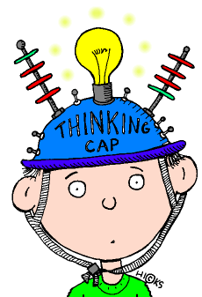
Meta-learning Strategies to Support Student Success
Lilly Teaching and Learning Conference, Traverse City, October 17-19 2019
Judith Ableser PhD- Director
Center for Excellence in Teaching and Learning
Oakland University
ableser@oakland.edu

Slide 2
Think-Pair-Share
Think- Write
Why are you at this session?
What do you hope to gain from this session?
Pair-Share

Slide 3
Motivation
For successful learning to occur, we all have to
  “want” to learn
  be motivated- extrinsic or intrinsic
    Extrinsic rewards such as grades are rarely as successful for “deep and long term learning” as some “intrinsic” value in learning
  see it as meaningful, purposeful, relevant
  builds on past knowledge and experiences
  connects to their own goals and personal/professional life

Slide 4
Welcome and Introductions
Who are you?
Who am I?
  Judy Ableser- Director of Center for Excellence in Teaching and Learning (CETL) at Oakland University
    CETL (Christina Moore and I) developed strategies and a handbook for faculty and students on Learning How to Learn
    Incorporated strategies highlighted in Dr. Barbara Oakley’s MOOC on Learning How to Learn

Slide 5
Agenda
Welcome
Introductions and Think-Pair-Share
Agenda and Learning Outcomes
Meta-learning
Learning to Learn Strategies (and Handbook)
What is in it for Me?
Goal Setting and Action Plan
Organizational Templates
Accountability Coach
Metacognitive Note-Taking
Class Content Note-Taking Templates
Productive Motions for Studying
Reading Strategies
Study Strategies
Reflection and Takeaways
Wrap-Up and Debrief

Slide 6
Learning Outcomes
Participants will be able to:
Participants will be able to describe how and why meta-cognitive strategies helps students be more successful in the classroom.
Participants will practice and apply some meta-cognitive strategies that they can use in their own classrooms.
Participants will be to modify and create a handbook and resources of meta-cognitive strategies that they can share with their students.

Slide 7
Learning to Learn
Metacognition- thinking about thinking- thinking about how we learn
Meta-learning- strategies we use to help us learn and be successful
Based on Brain research, learning theories and evidence- based practices
Helps us become independent, self-directed learners
Can apply to individual class, university career, and most importantly, can assist in life-long success in personal and professional world

Slide 8
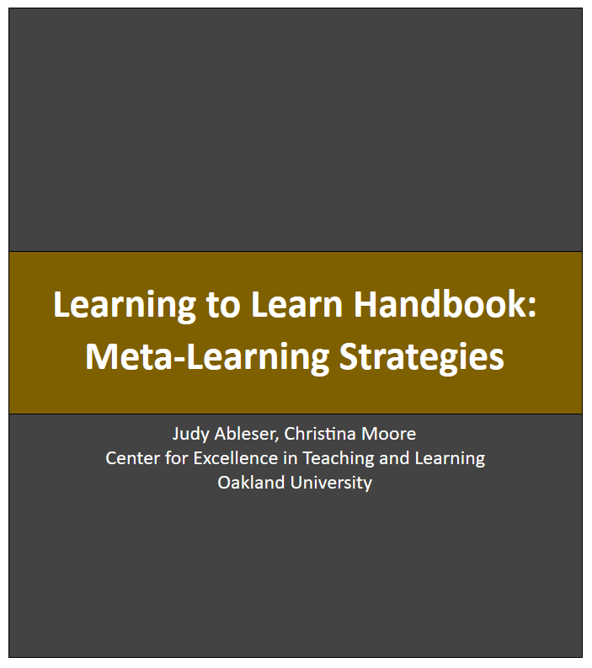
Learning to Learn Handbook https://www.oakland.edu/cetl/resources/#tab-5

Slide 9
Key Points of Meta-learning Strategies
Time- Need to take time upfront to learn some of these strategies but great pay off in time and results in long run
  For instructor- take time during first few classes to teach “learning to learn strategies”
Practice- For a new behavior to become a habit, must practice for 21 days
  For instructor- remind and give students opportunities to practice
Individual Preference- We all have our own preferences and styles. Not all techniques work the same for each person. Try and see if these “fit” and what strategies might each person prefer

Slide 10
Behaviors and Conditions for Learning
Physical and psychological safety
Sleep
Peace, no anxiety
Address procrastination
Growth mindset

Slide 11
Strategies for Students-
We will look at some of these together and then you can explore and discuss others in small groups
What’s in it for Me?- pg 27
Goal Setting and Action plan- pg 28
Organizing for Success- pg 29
Accountability Coach- pg 30
Meta-cognitive Note Taking- pg 31
Class Content- Note taking- pg 32
Productive Motions for Studying and Learning- pg 33
Strategies for College Level Reading- pg 34
Strategies for Studying-pg 35
Debriefing and Take-aways- pg. 36

Slide 12
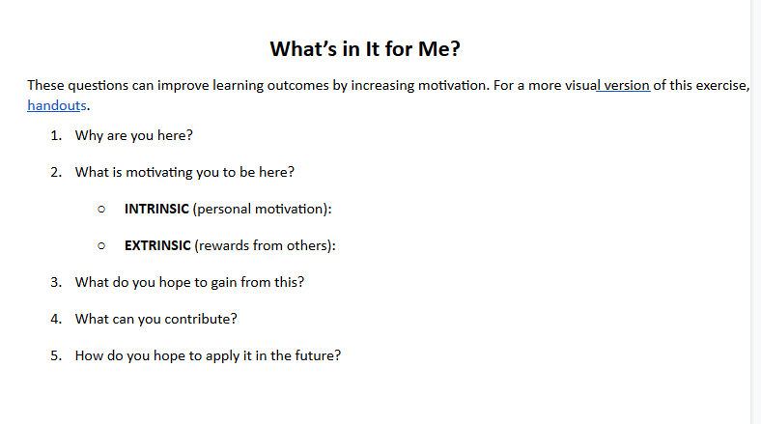
Strategy #1- What is in it for Me?

Slide 13
Goals and Action Plan
“ Goals without a plan are merely dreams”
Goals
  Realistic
  Attainable
  Valuable
  Review and Revise
Action Plan
  Realistic-Balanced with life
  Prioritize
  Follow-through and follow-up
  Review and Revise

Slide 14
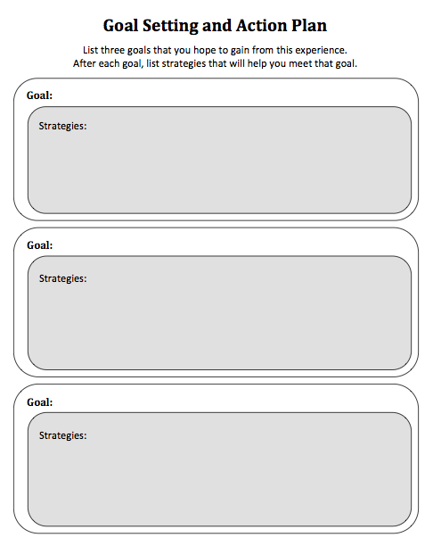
Strategy #2- Goals and Action Plan

Slide 15
Organization
“Best laid plans…..”
May have goals and may have plan but need to have an “organizational system” to stay on track
To-Do Lists
  Semester Goals
  Monthly Lists
  Weekly Lists
Organizational Calendar
  Tip- Take all syllabi and transfer all important dates onto weekly/monthly calendar (can be color coded)
  1. Class meeting times
  2. Assignment/Tests Due Dates
  3. Readings
  4. Tasks

Slide 16
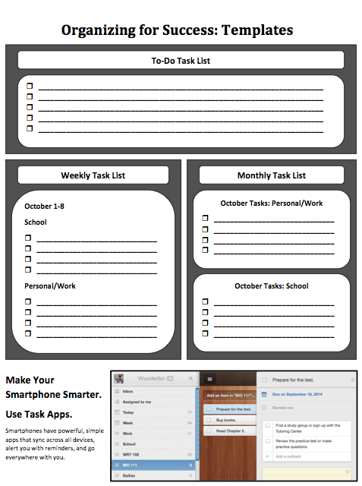
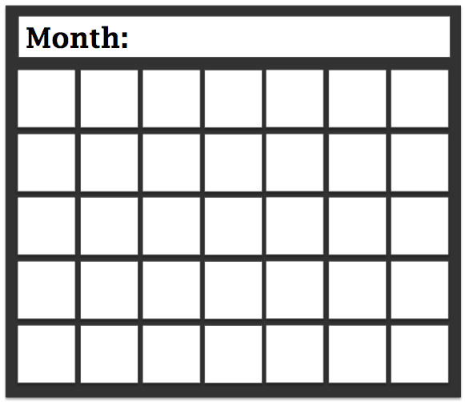
Organizational Templates

Slide 17
Accountability Coach
For many of us, one way to reach our goals is to “check” in with someone for encouragement, clarification, validation and confirmation.
Can be a friend, advisor, peer, faculty member
Peer buddy in a class. One first day find take a moment for each student to find a peer buddy (and exchange email address and info)- Creates sense of connection and community
Peer buddy can serve as Accountability Coach and can also be responsible for
  Clarification of content
  Reviewing content- study-buddy
  Taking-notes and collecting hand-outs if peer is absent

Slide 18
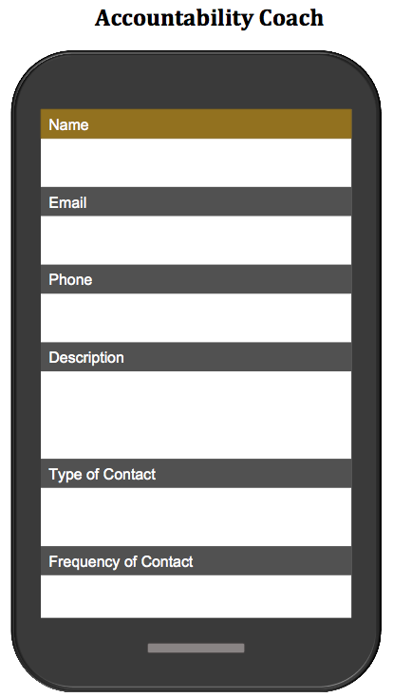
Strategy #4- Accountability Coach + Peer Buddy
Handbook
  Name
  Email
  Phone
  Something interesting about my coach
  Type of contact
  Frequency of contact

Slide 19
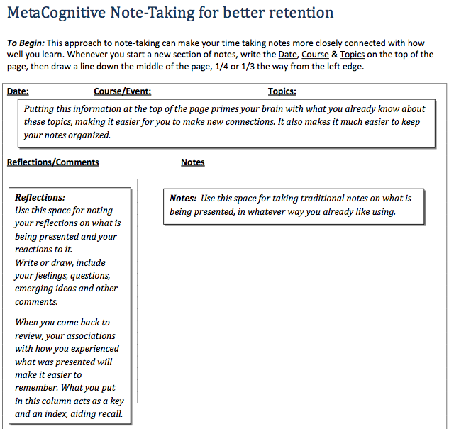
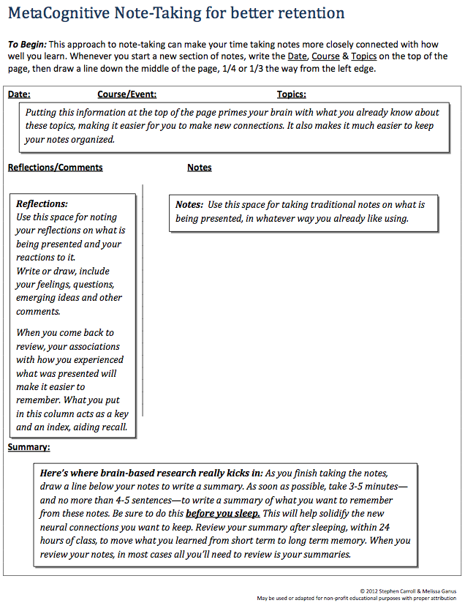
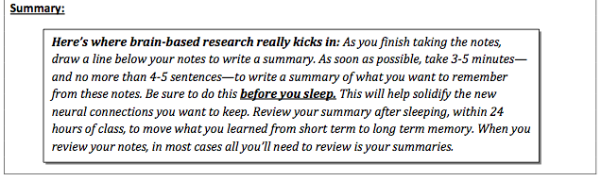
Meta-cognitive Note Taking (Carroll, S. & Ganus, M. 2012)

Slide 20
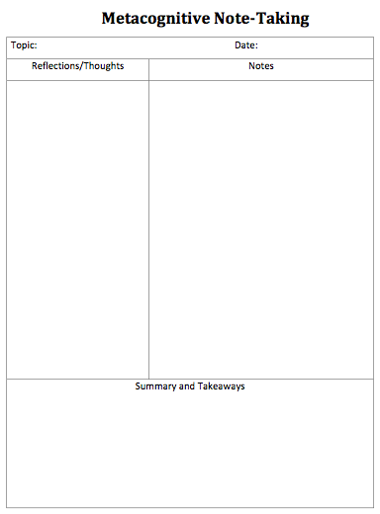
Strategy # 5- Meta-cognitive Note Taking

Slide 21
Meta-Cognitive Note Taking
Try using the template for the remainder of the session
Hand-written notes vs type written notes
  Personal Preference
  Research suggests that “hand-writing” your notes are more effective
  Can have students do their own mini-study by trying both approaches

Slide 22
Schematic or Concept Maps
Visual or graphic representations to help organize and build on ideas/content/concepts
Schematic or concept maps allow us to group, chunk, see the flow, and create connections of ideas/content/concepts
A wide range of schematic maps exist (and we can create other ones). Selection of schemas depend on:
  Personal preference
  Task at hand

Slide 23
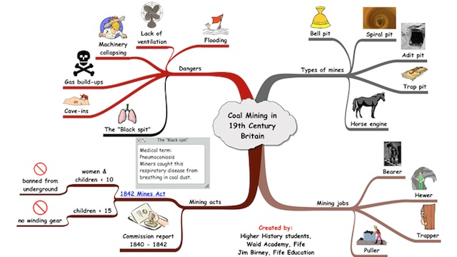
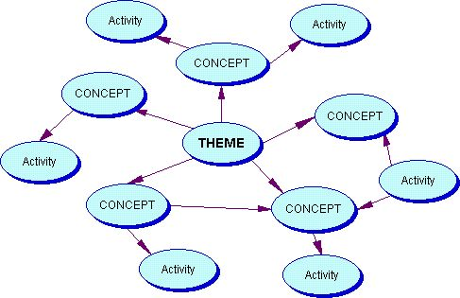
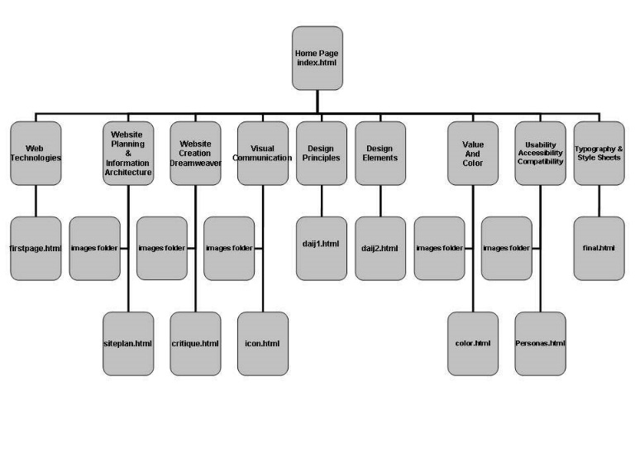
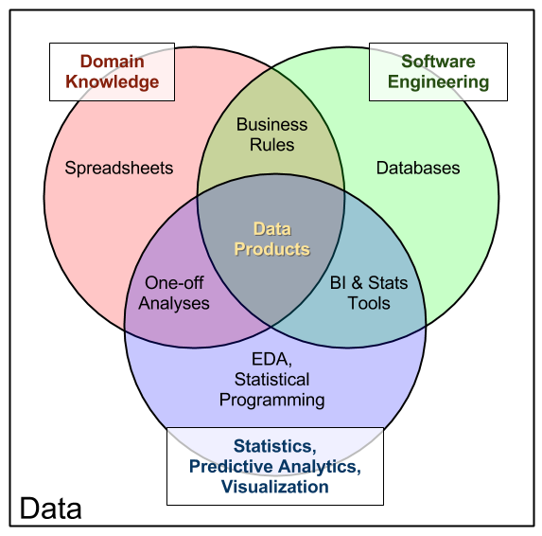
Examples of Concept or Schematic Maps

Slide 24
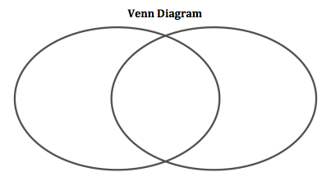
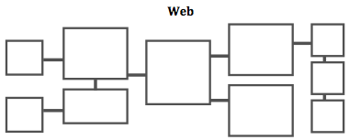
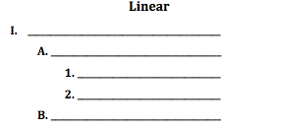
Strategy #6- Concept/Schematic Maps

Slide 25
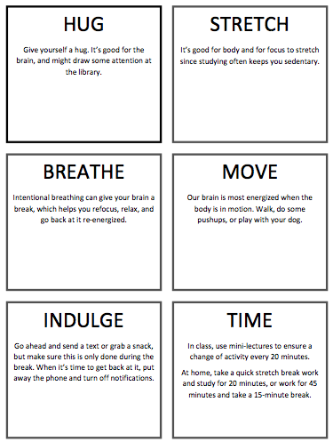
Strategy # 7- “Give Yourself a Hug”
  Tips for Class Breaks
    Give yourself a hug
    Stretch
    Breath
    Move about room
    Texting break
    Bathroom break
    Tips for working on assignments
      When taking a break
        Set small goals and break when accomplished task
        Set timer for breaks
        When take the break- clean house, put load of wash in the laundry, get some fresh air

Slide 26
Physical and Mental Breaks
“Brain can only absorb what the backside can withstand” (one of my favorite lines from a wise professor of mine)
We need breaks while learning
  Physical
  Mental
For instructors-
  in class provide mini-lectures/lessons of no more than 20 minutes followed by an activity
  provide breaks with physical activities (stretch, move about room, mix and mingle)
For learners- when working or studying
  Work for 20 minutes- take short 5 minute break
  Work for 45 minutes- take 15 minute break
Individual Preference
  Some people can work for in short spurts others need “chunks” of time when working on major projects
  Find what works best for individual

Slide 27
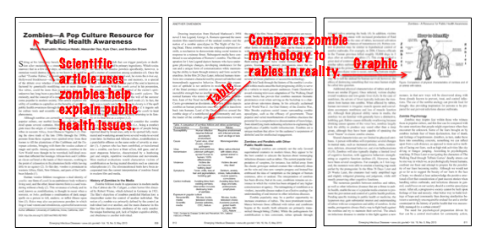
Strategy #8 Reading Strategies
Pre-Read Read Critically Post-Read
Scan the text. Articulate the context and purpose. Think about the topic.

Slide 28
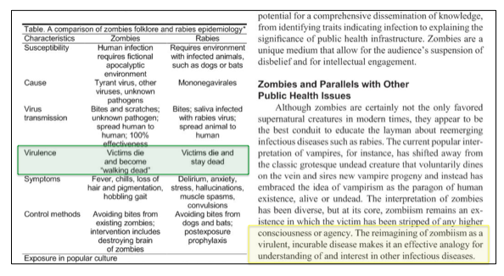
Strategy #8 Reading Strategies
Pre-Read Read Critically Post-Read
Use one highlighter for key concepts and another for questions.
Keep a reading journal.

Slide 29
Strategy #8 Reading Strategies
  Review and reflect (pre-reading and notes)
  Summary before switching gears/before sleep
  Review within 24 hours
Pre-Read Read Critically Post-Read

Slide 30
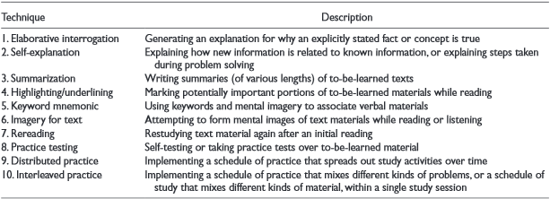
Study on Popular Study Techniques

Slide 31
Popular Study Techniques
Elaborative Interrogation
Self-Explanation
Summarization
Highlighting
Keyword Mnemonic
Imagery for Text
Rereading
Practice Testing
Distributed Practice- small chunks across time
Interleaved Practice

Slide 32
Study Tools
Activity- in small groups, share
What techniques you use(d) to study
What techniques you think students use most often
What techniques you think are most effective

Slide 33
Popular Study Techniques
L= low impact M= medium impact H= High Impact
Elaborative Interrogation- (M)
Self-Explanation (M)
Summarization (L)
Highlighting (L)
Keyword Mnemonic (L)
Imagery for Text (L)
Rereading (L)
Practice Testing (H)
Distributed Practice (H)
Interleaved Practice (M)

Slide 34
Strategy # 9- Study Strategies
Practice Testing
Create your own test questions.
Prompts
Why …
Describe …
Compare and Contrast …
Outline …
Distributed Practice
Spread out studying over several days and periods.
Calendar planning helps automate this productive study habit.

Slide 35
Group Activity
At your tables share a strategy or technique that you have used or know of that you feel is valuable
to help students become more self-directed, successful learners.
  and/or
  Spend time reviewing these strategies and decide which ones would work best for you or for your students

Slide 36
Reflective Practice and Take-away
“Deep learning” happens when you retain, apply/transfer, use the new “knowledge, skills or behaviors” over time.
In order to help solidify and integrate this, it helps to reflect and debrief on the experience

Slide 37
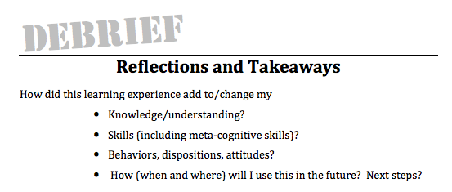
Strategy #10- Reflect and Take-away
Additional Reflections

Slide 38
Wrap-Up
Did we:
Participants will be able to describe how and why meta-cognitive strategies helps students be more successful in the classroom.
Participants will practice and apply some meta-cognitive strategies that they can use in their own classrooms.
Participants will be able to modify and create a handbook and resources of meta-cognitive strategies that they can share with their students.

Slide 39
References and Resources
Ambrose, S.; Bridges, M.; DiPietro, M.; Lovett , M.; Norman, M. & Mayer, R. (2012). How learning works: Seven research based principles for smart teaching. Boston, MA: John Wiley & Sons Inc.
Bain, K. (2004). What the best college teachers do. Cambridge, MA: Harvard University Press
Bain, K. (2012). What the best college students do. Cambridge, MA: Harvard University Press
Carroll, S. & Ganus, M. (2012) Meta-cognitive note-taking for better retention (hand-out)
Desautel, D. (2009). Becoming a thinking thinker: Metacognition, self-reflection, and classroom practice. Teachers College Record, 111(8), 1997-2020.
Doyle, T. & Zakrajsek, T. (2013). The new science of learning. Sterling, VA: Stylus Publishing

Slide 40
Dunlosky J., Rawson, Marsh, Nathan, &Willingham. (2013). Improving students’ learning with effective learning techniques: Promising directions from cognitive and educational psychology. Psychological Science in the Public Interest, 14, 4–5
Kaplan, M., Silver, N., LaVaque-Manty, D., Meizlish, & D. Rhem, J. (2013) Using reflection and metacognition to improve student learning: Across the disciplines, across the academy (new pedagogies and practices for teaching in higher education). Sterling, VA: Stylus Publishing
Kolencik, P. & Hillwig, S. (2011). Encouraging metacognition: Supporting learners through metacognitive teaching strategies. New York, NY: Peter Lang Publishing,
Nilson, L. & Zimmerman, B. (2013) Creating self-regulated learners: Strategies to strengthen students' self-awareness and learning skills. Sterling, VA: Stylus Publishing
Svinicki, M. & McKeachie, W. (2011) McKeachie's teaching tips: Strategies, research, and theory for college and university teachers, 13th Ed. Belmont, CA: Wadsworth Cengage Learning

